Slide 1
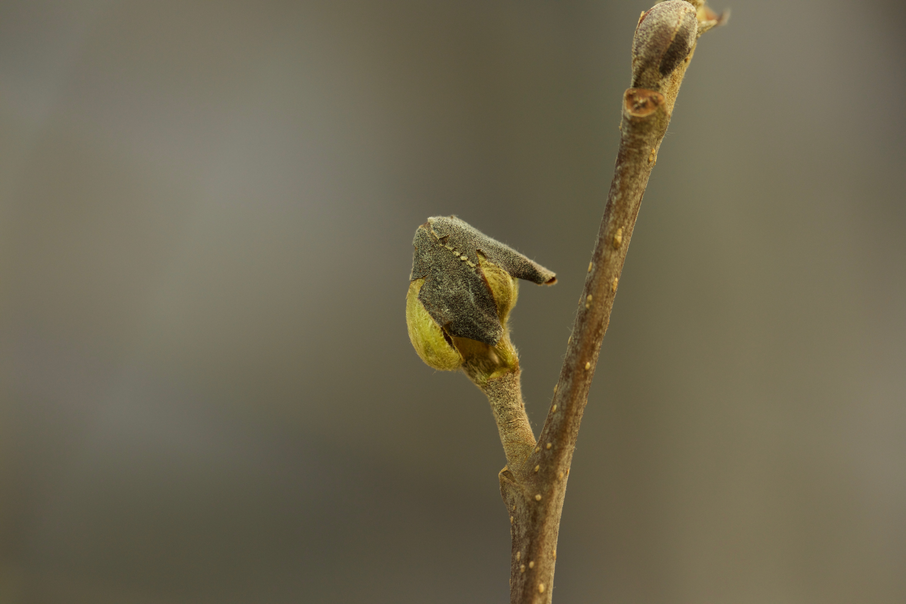
Climate change reshapes the drivers of false spring risk in European trees
Cat Chamberlain
Arnold Arboretum – Harvard University

Slide 2
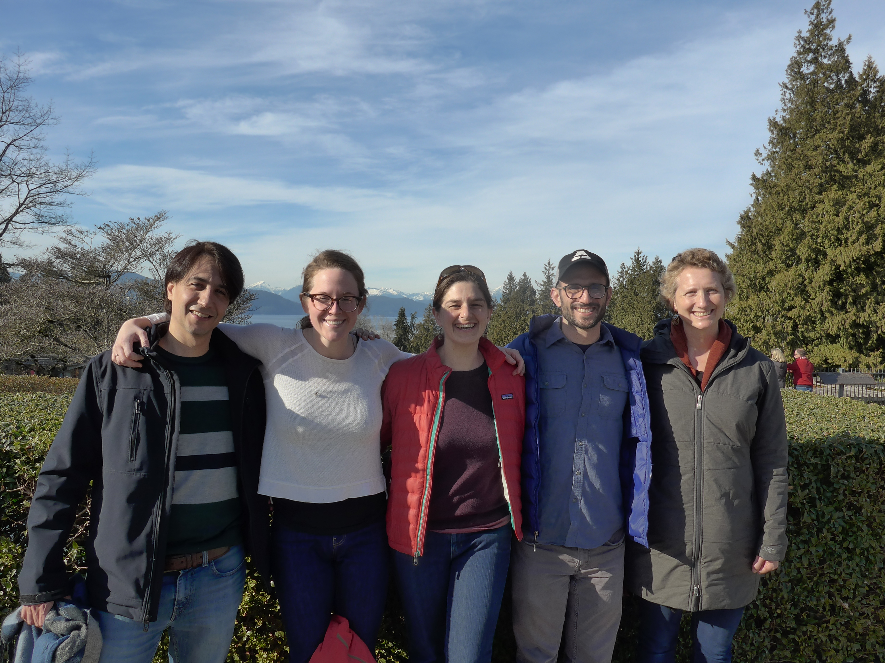

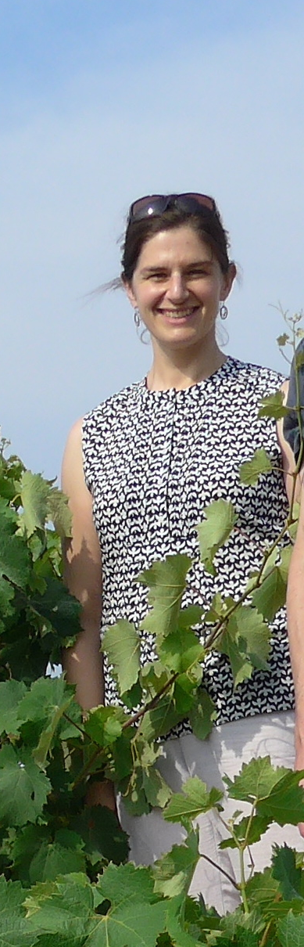

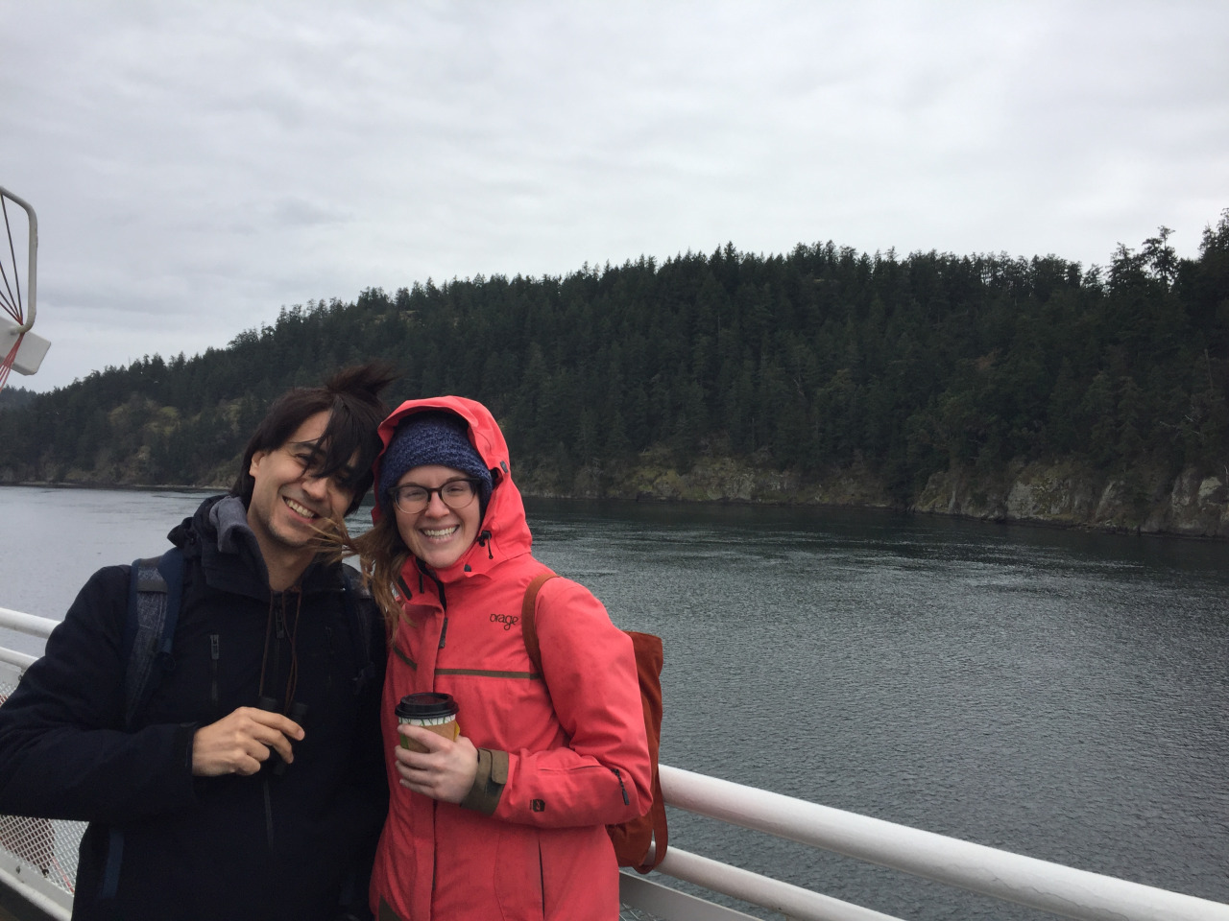


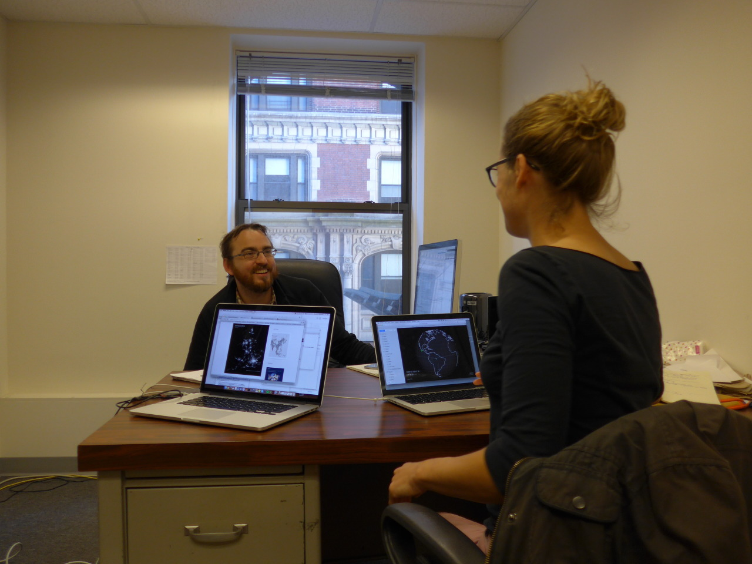
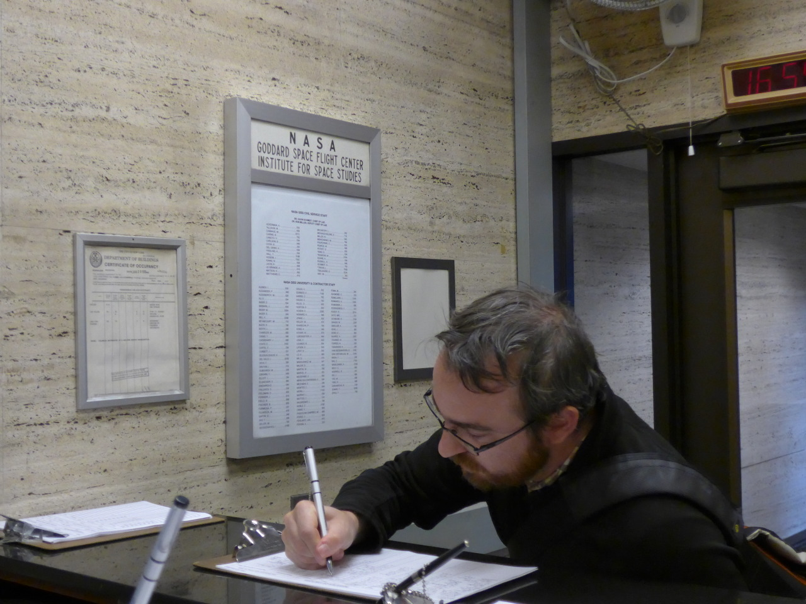
COAUTHORS

Slide 3

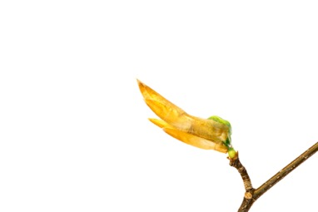
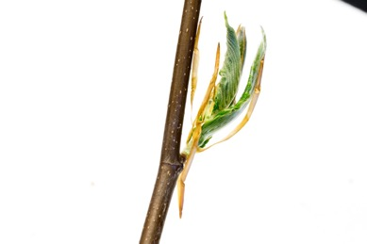
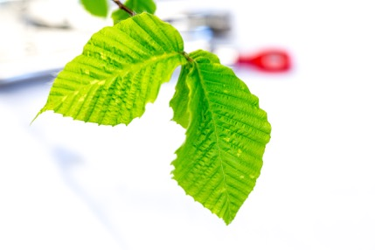
Phenology: timing of life history events
DORMANT BUD
BUDBURST
LEAFOUT
Photos by Tim Savas
American Beech: Fagus sylvatica

Slide 4
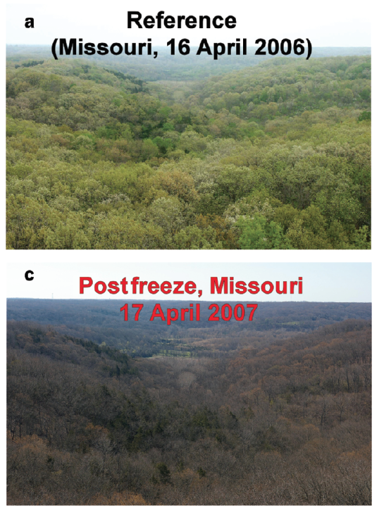
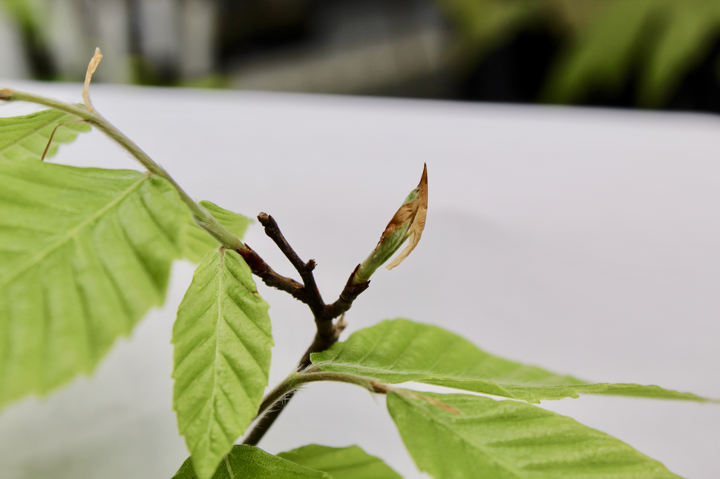
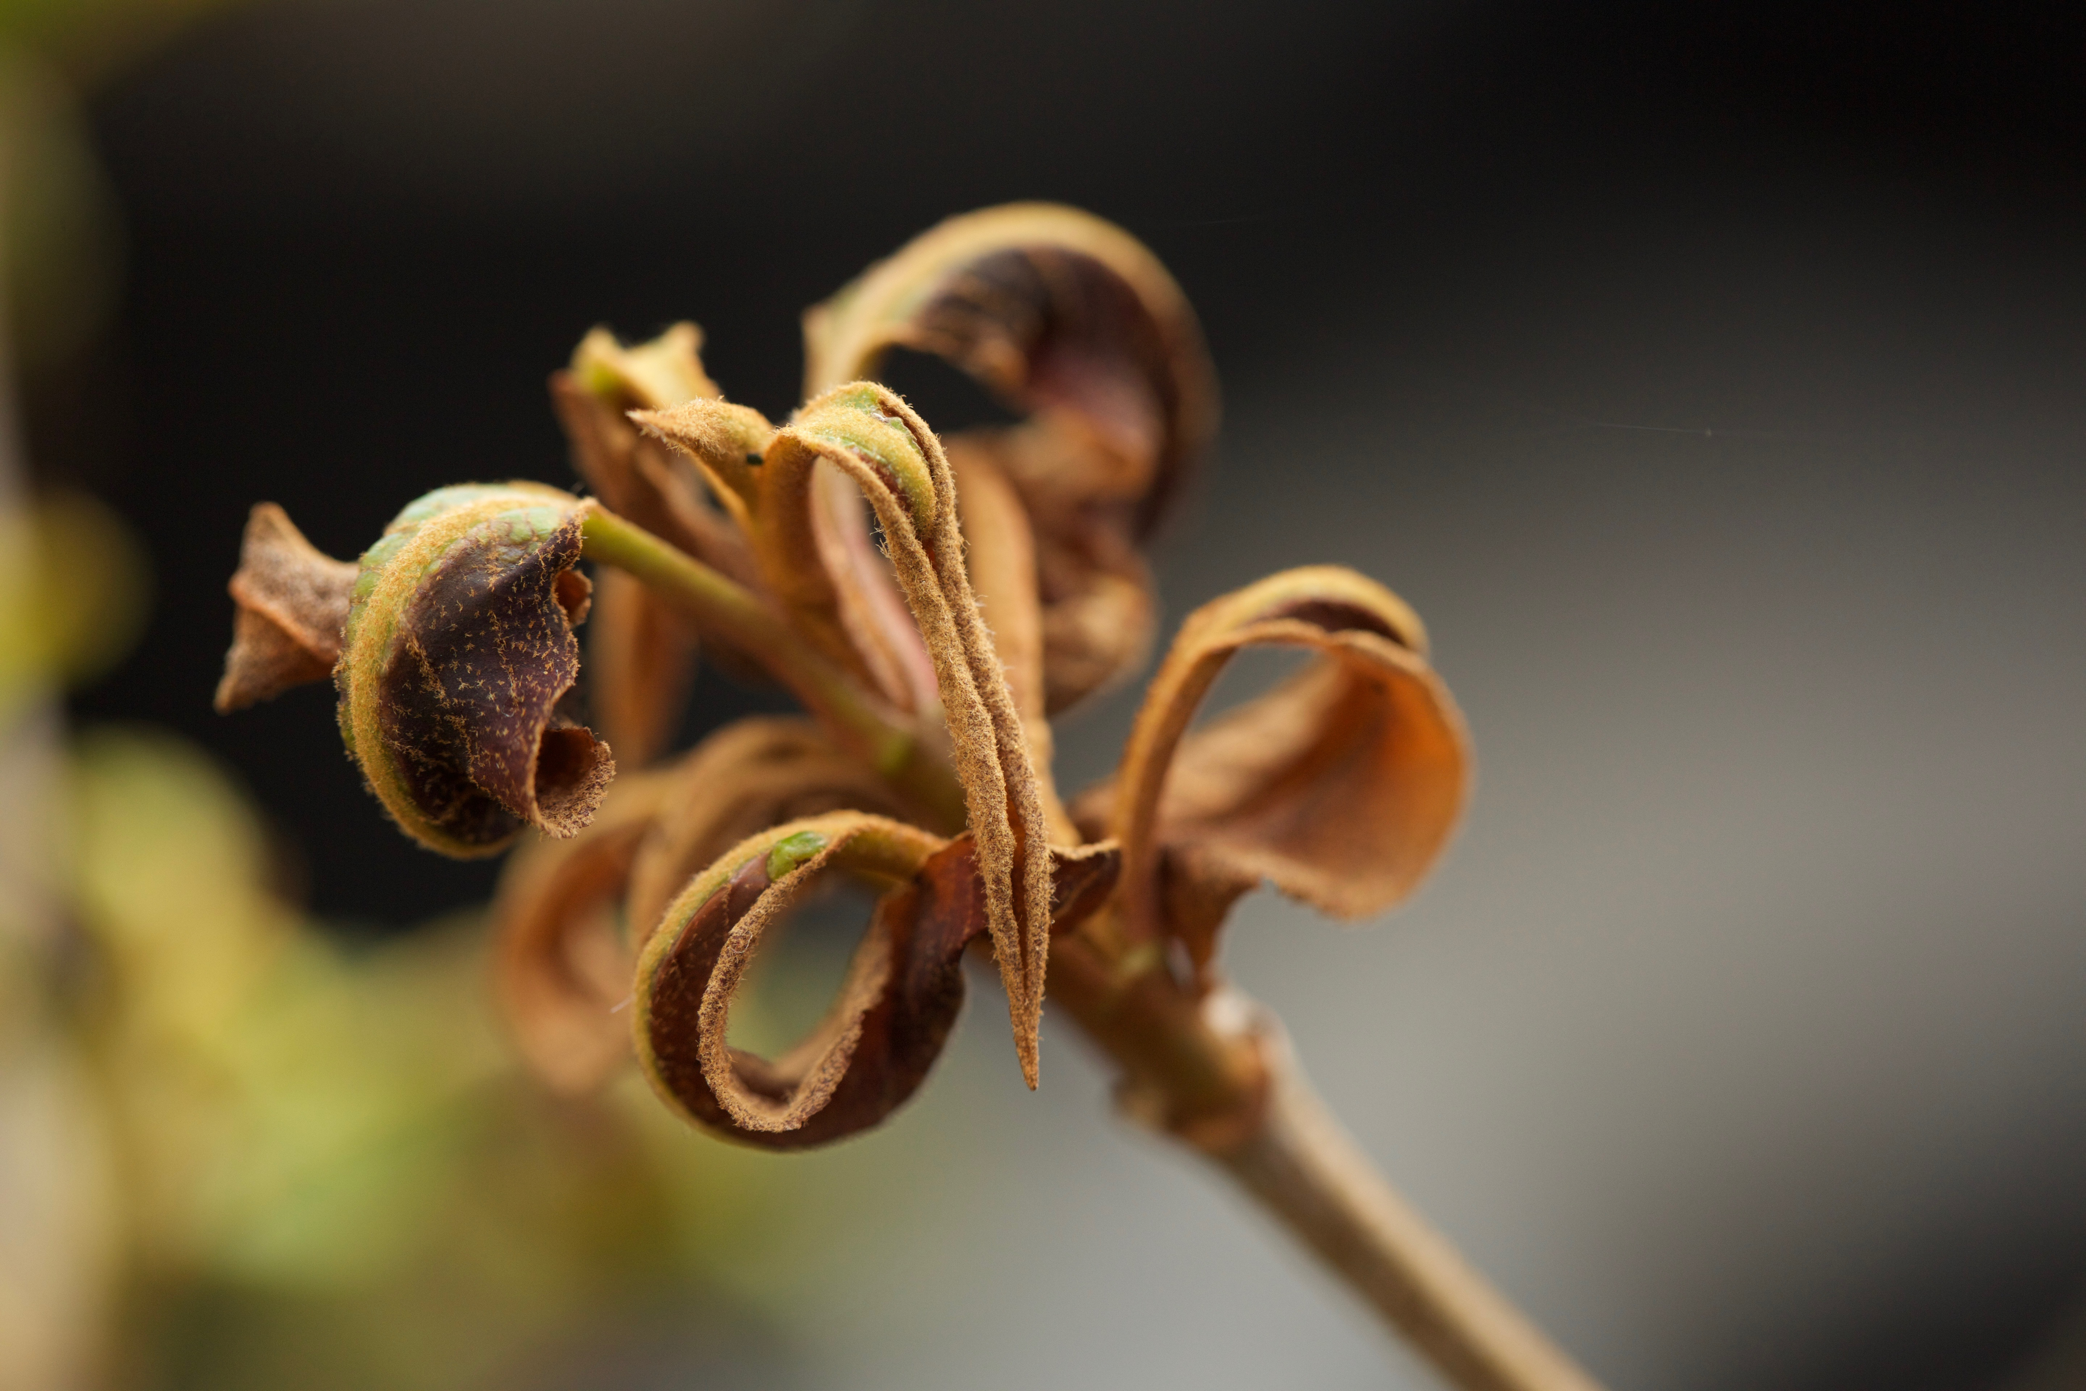
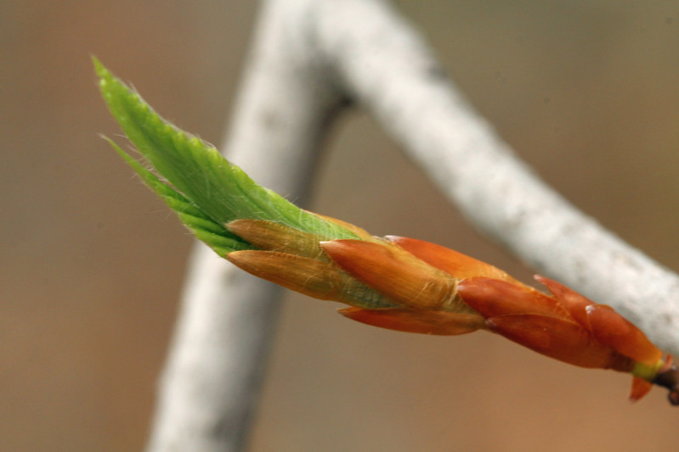
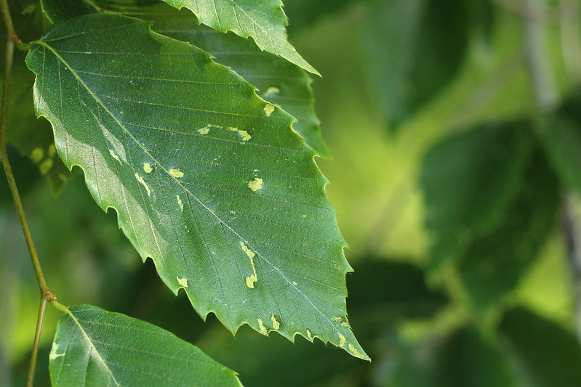
False Spring: freezing temperatures after budburst has initiated
Budburst
Leafout
Gu et al, 2007

Slide 5
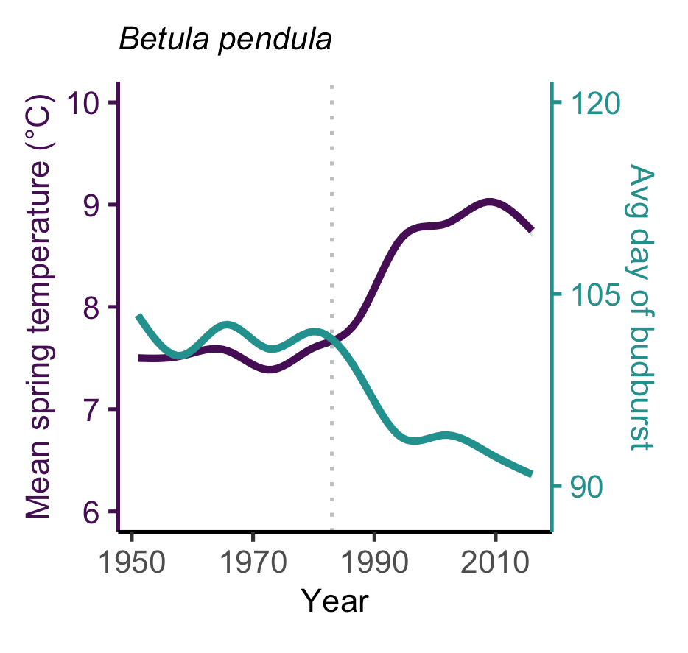
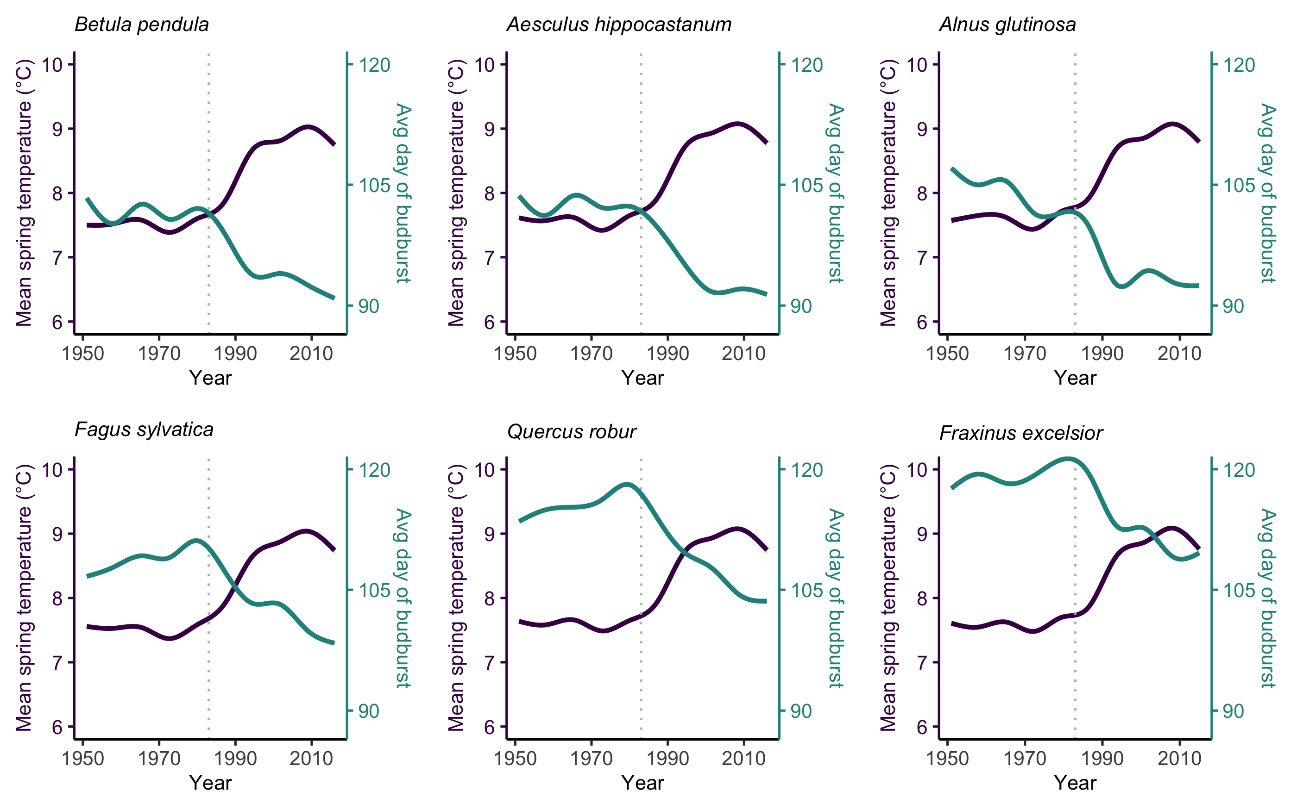
PHENOLOGY IS ADVANCING
1984
Chamberlain et al, in review

Slide 6
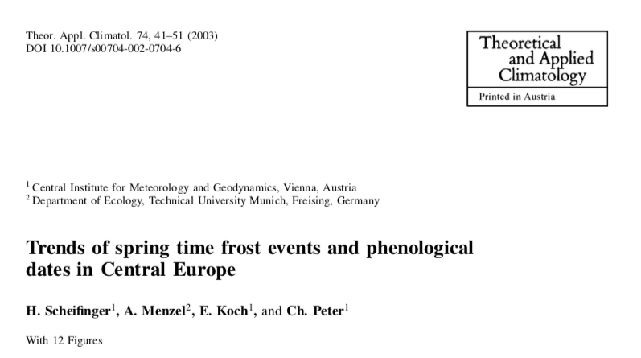
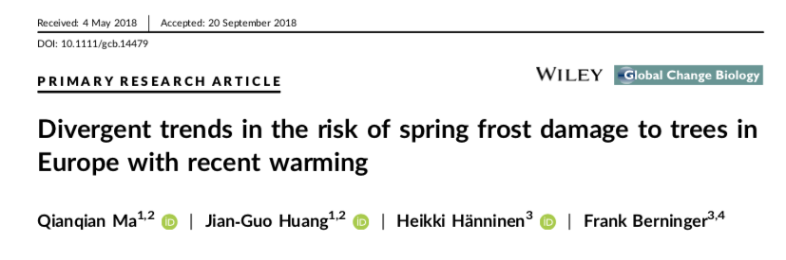
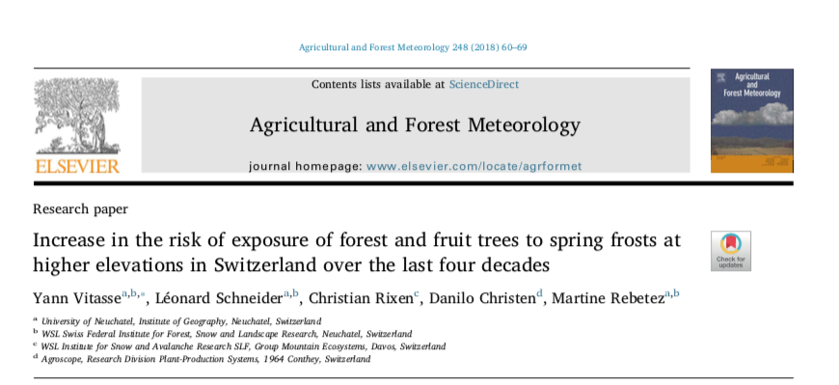
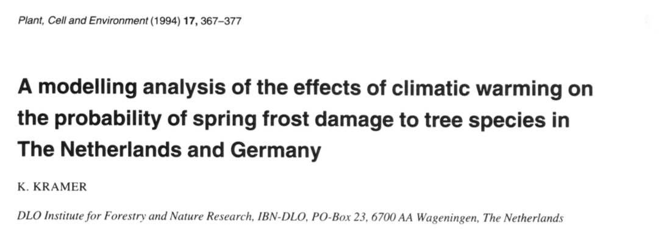
Is false spring risk changing with climate change?
Notes:
I liked the slide of all the contrasting results -- this is you setting up the problem -- so be sure to state it clearly. I think you could pause for a moment here 'we have contrasting results of whether false spring is increasing or decreasing and why, but we critically need an answer to this to forecast future [productivity, ecosystems, forests, communities... take your pick].' Then you can say, 'one issue is that most papers focus on only one driver, but multiple factors drive false spring so we wanted to address this.'

Slide 7
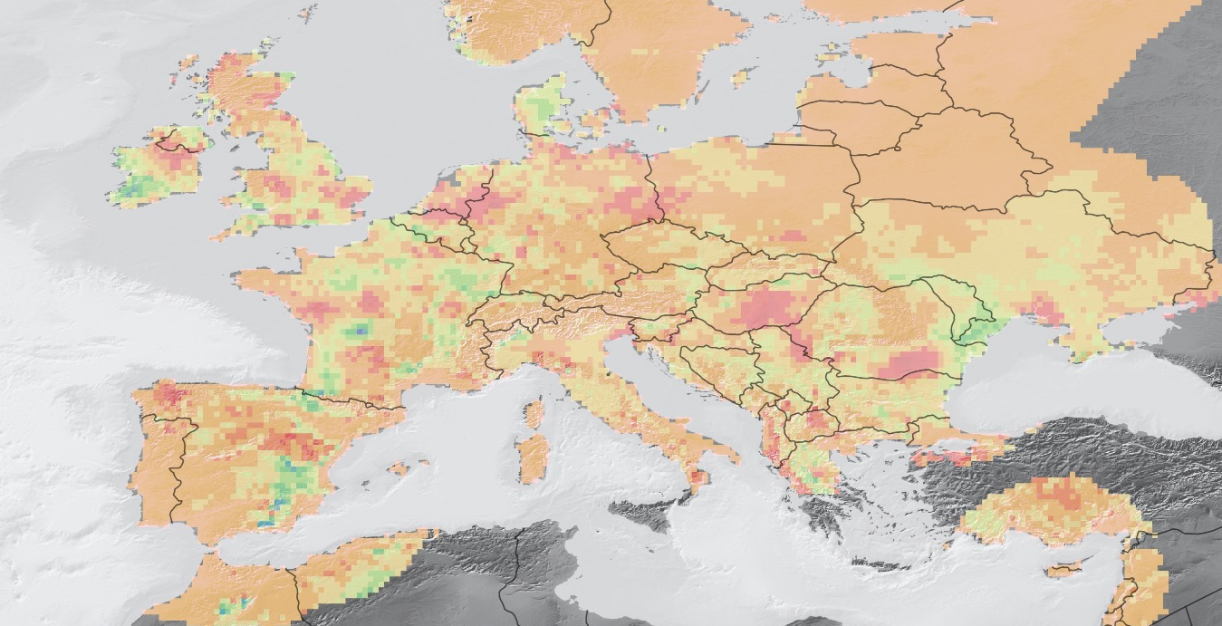
Is climate change reshaping false spring risk?
Green/blue = DECREASING with climate change
Orange/red = INCREASING with climate change

Slide 8

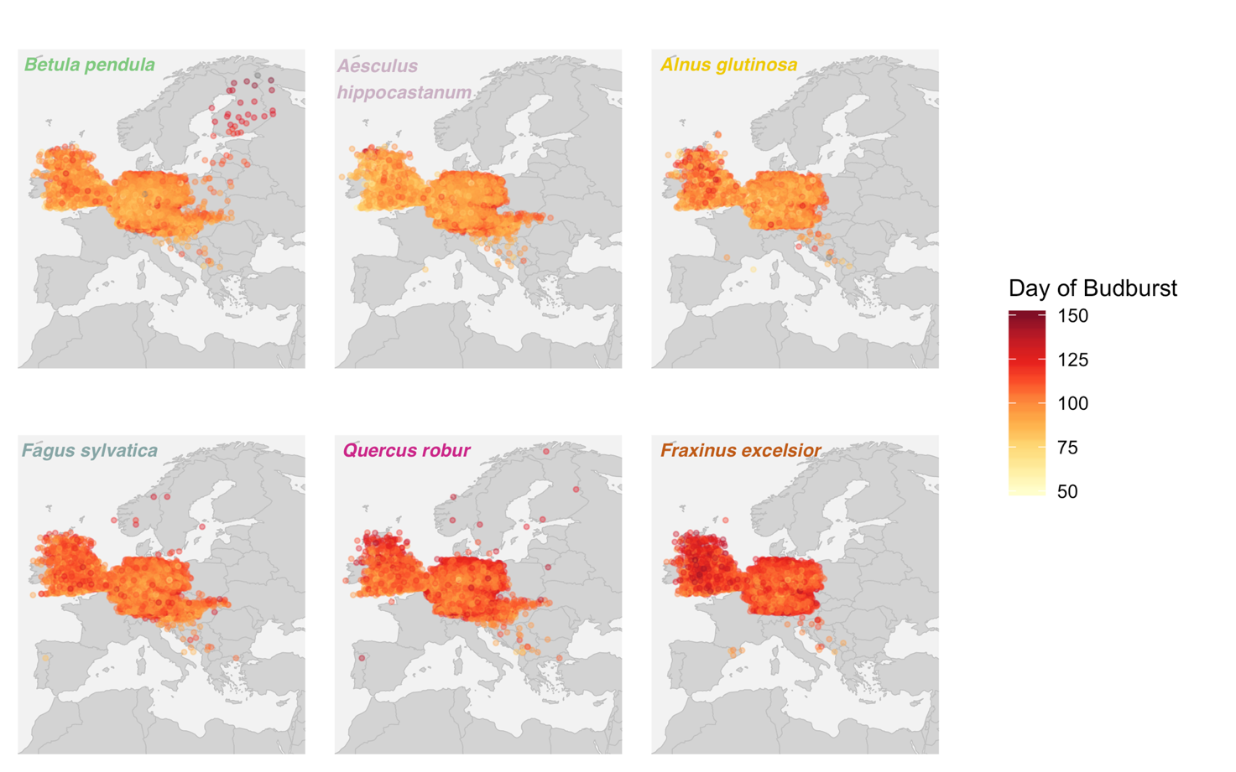
Leafout data for six temperate European trees
EARLY-LEAFOUT SPECIES:
historically MORE at risk of false springs
LATE-LEAFOUT SPECIES:
historically LESS at risk of false springs
Chamberlain et al, in review

Slide 9
What geographic and climatic factors contribute to a plant’s risk?
Mean spring temperature
Elevation
Distance from the coast
NAO index
Space Parameter
Recent climate change
Recent climate change
Recent climate change
Recent climate change
Recent climate change
Notes:
Inland individuals at higher risk
NAO: high NAO leads to higher than average winter and spring temperatures, earlier budburst

Slide 10
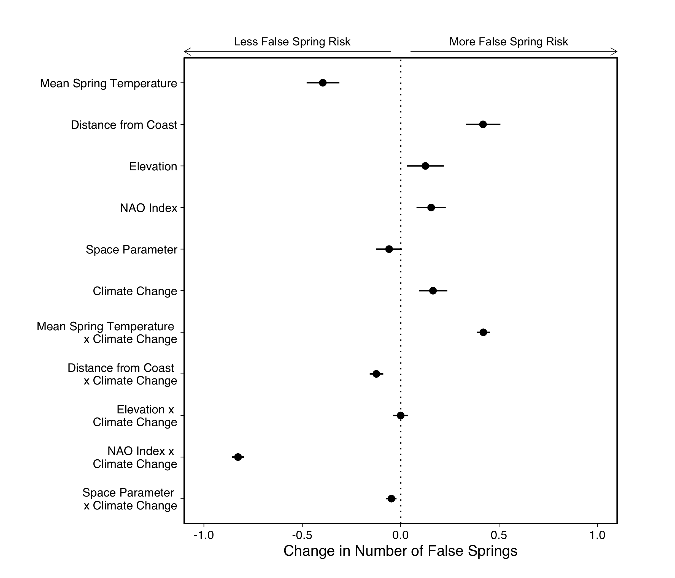
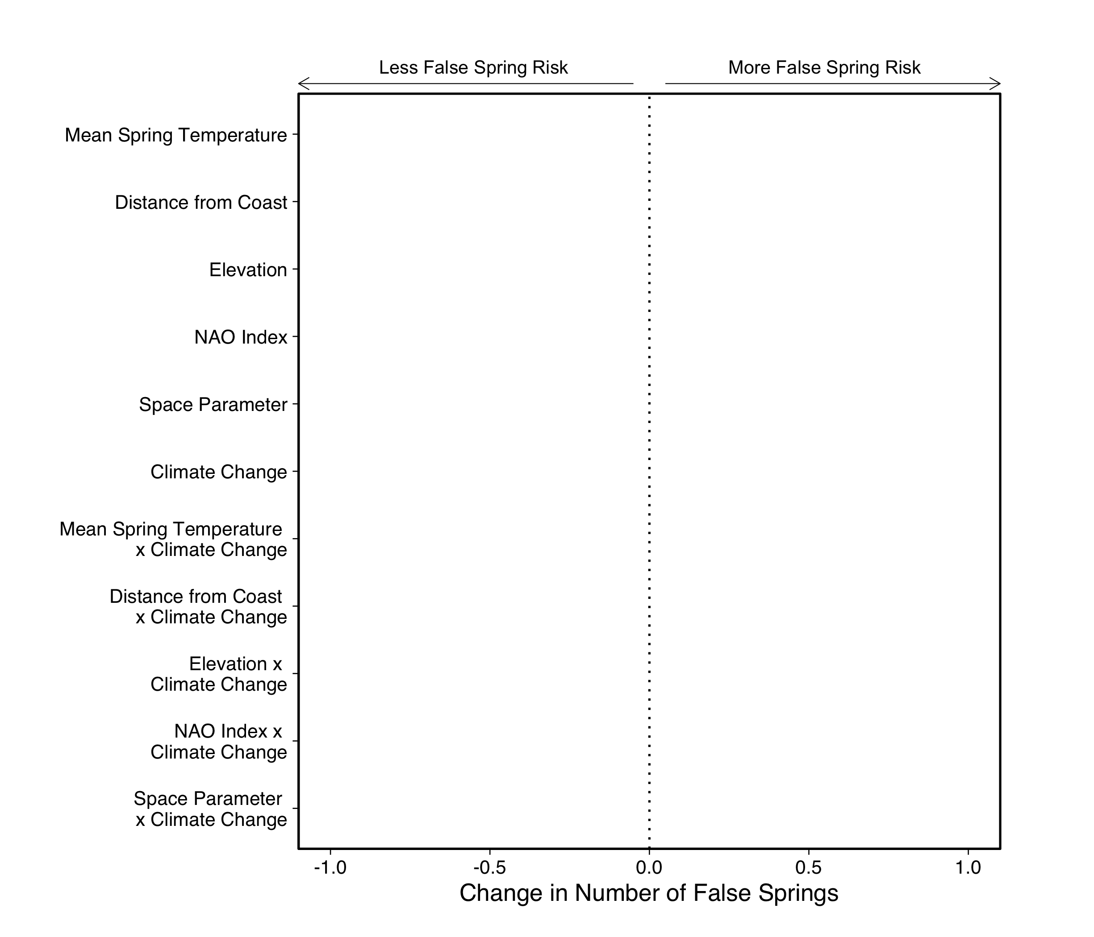
Mean spring temperature and distance from the coast were the strongest predictors
But climate change complicates things…
Risk increases with warmer springs
But there is substantially less risk with more positive NAO indices
Chamberlain et al, in review
Notes:
Verbally define your dots and lines ('circles and lines represent the means plus XX% uncertainty intervals from our Bayesian model') in the mu plots.

Slide 11
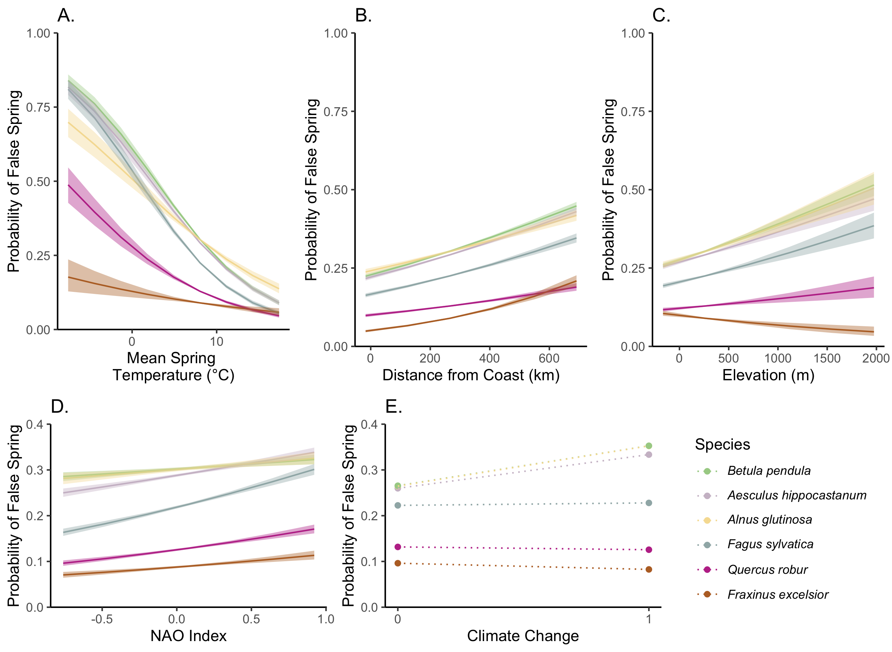
Among species variation
Consistent trends in direction across species for each predictor, except elevation
Variation in magnitude across species, especially mean spring temperature
Greater differences in risk between early-leafout species and late-leafout species
Chamberlain et al, in review
Notes:
I would not call FRAEXC divergence from the others species' trends a dichotomy -- I would call it more a difference or just that it diverges from the general trend of the other species or such.

Slide 12
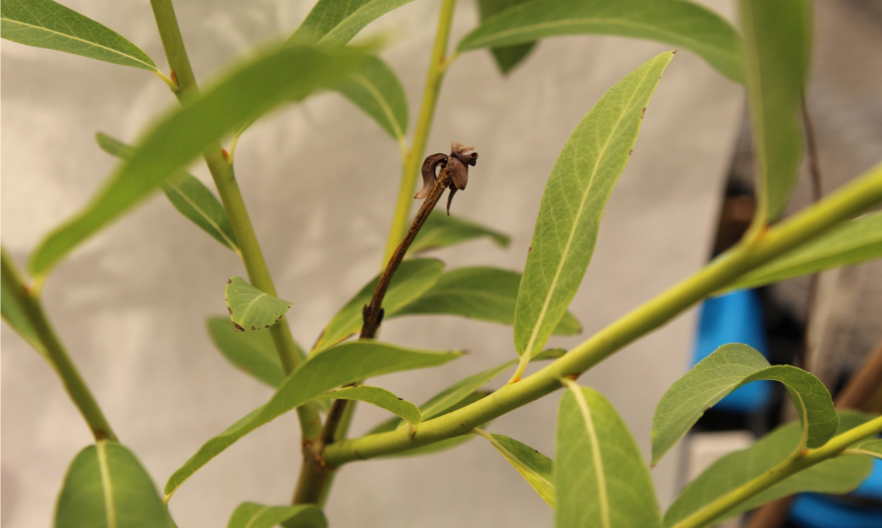

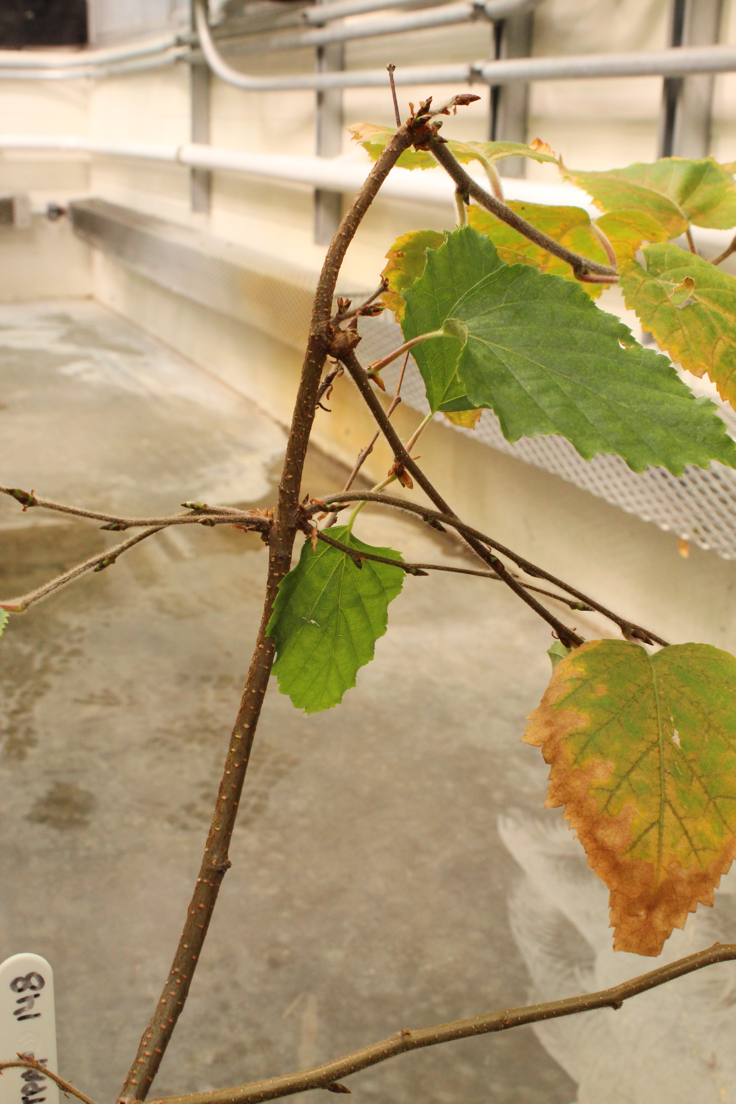
Conclusions
Mean spring temperature and distance from the coast are the strongest predictors for false spring risk
Climate change complicates forecasting and reshapes predictors
Species-level variation in risk is magnified after climate change
Space and time really matter!
Notes:
Inland individuals at higher risk
NAO: high NAO leads to higher than average winter and spring temperatures, earlier budburst

Slide 13





THE TEMPORAL ECOLOGY LAB
Lizzie Wolkovich, PhD
Dan Buonaiuto
Ignacio Morales-Castilla, PhD
Aileen Ettinger, PhD
Deirdre Loughnan
Darwin Sodhi
ARNOLD ARBORETUM - TREE SPOTTERS
Suz Mrozak
Danny Schissler
Kate Stonefoot
Pam Thompson
Our Citizen Scientists!!
COMMITTEE MEMBERS
Paul Moorcroft, PhD
Neil Pederson, PhD
COLLABORATORS AND SPECIAL THANKS
Iñaki Garcia de Cortazar-Atauri, PhD
Ben Cook, PhD
Kea Woodruff
Faye Rosin
Alice Linder
Dan Flynn
Alissandra Ayala
John O’Keefe, PhD
Audrey Barker Plotkin
THE HOLBROOK LAB
Noel Michele Holbrook, PhD
Fulton Rockwell, PhD
Jess Gersony
Anju Manandhar
Meghan Blumstein
Morgan Furze, PhD
Zhe He

Slide 14
What is a false spring?
Freezing temperatures following a warm period
Typically in early spring, after dormancy is released
Can be very damaging
Gu et al, 2007

Slide 15
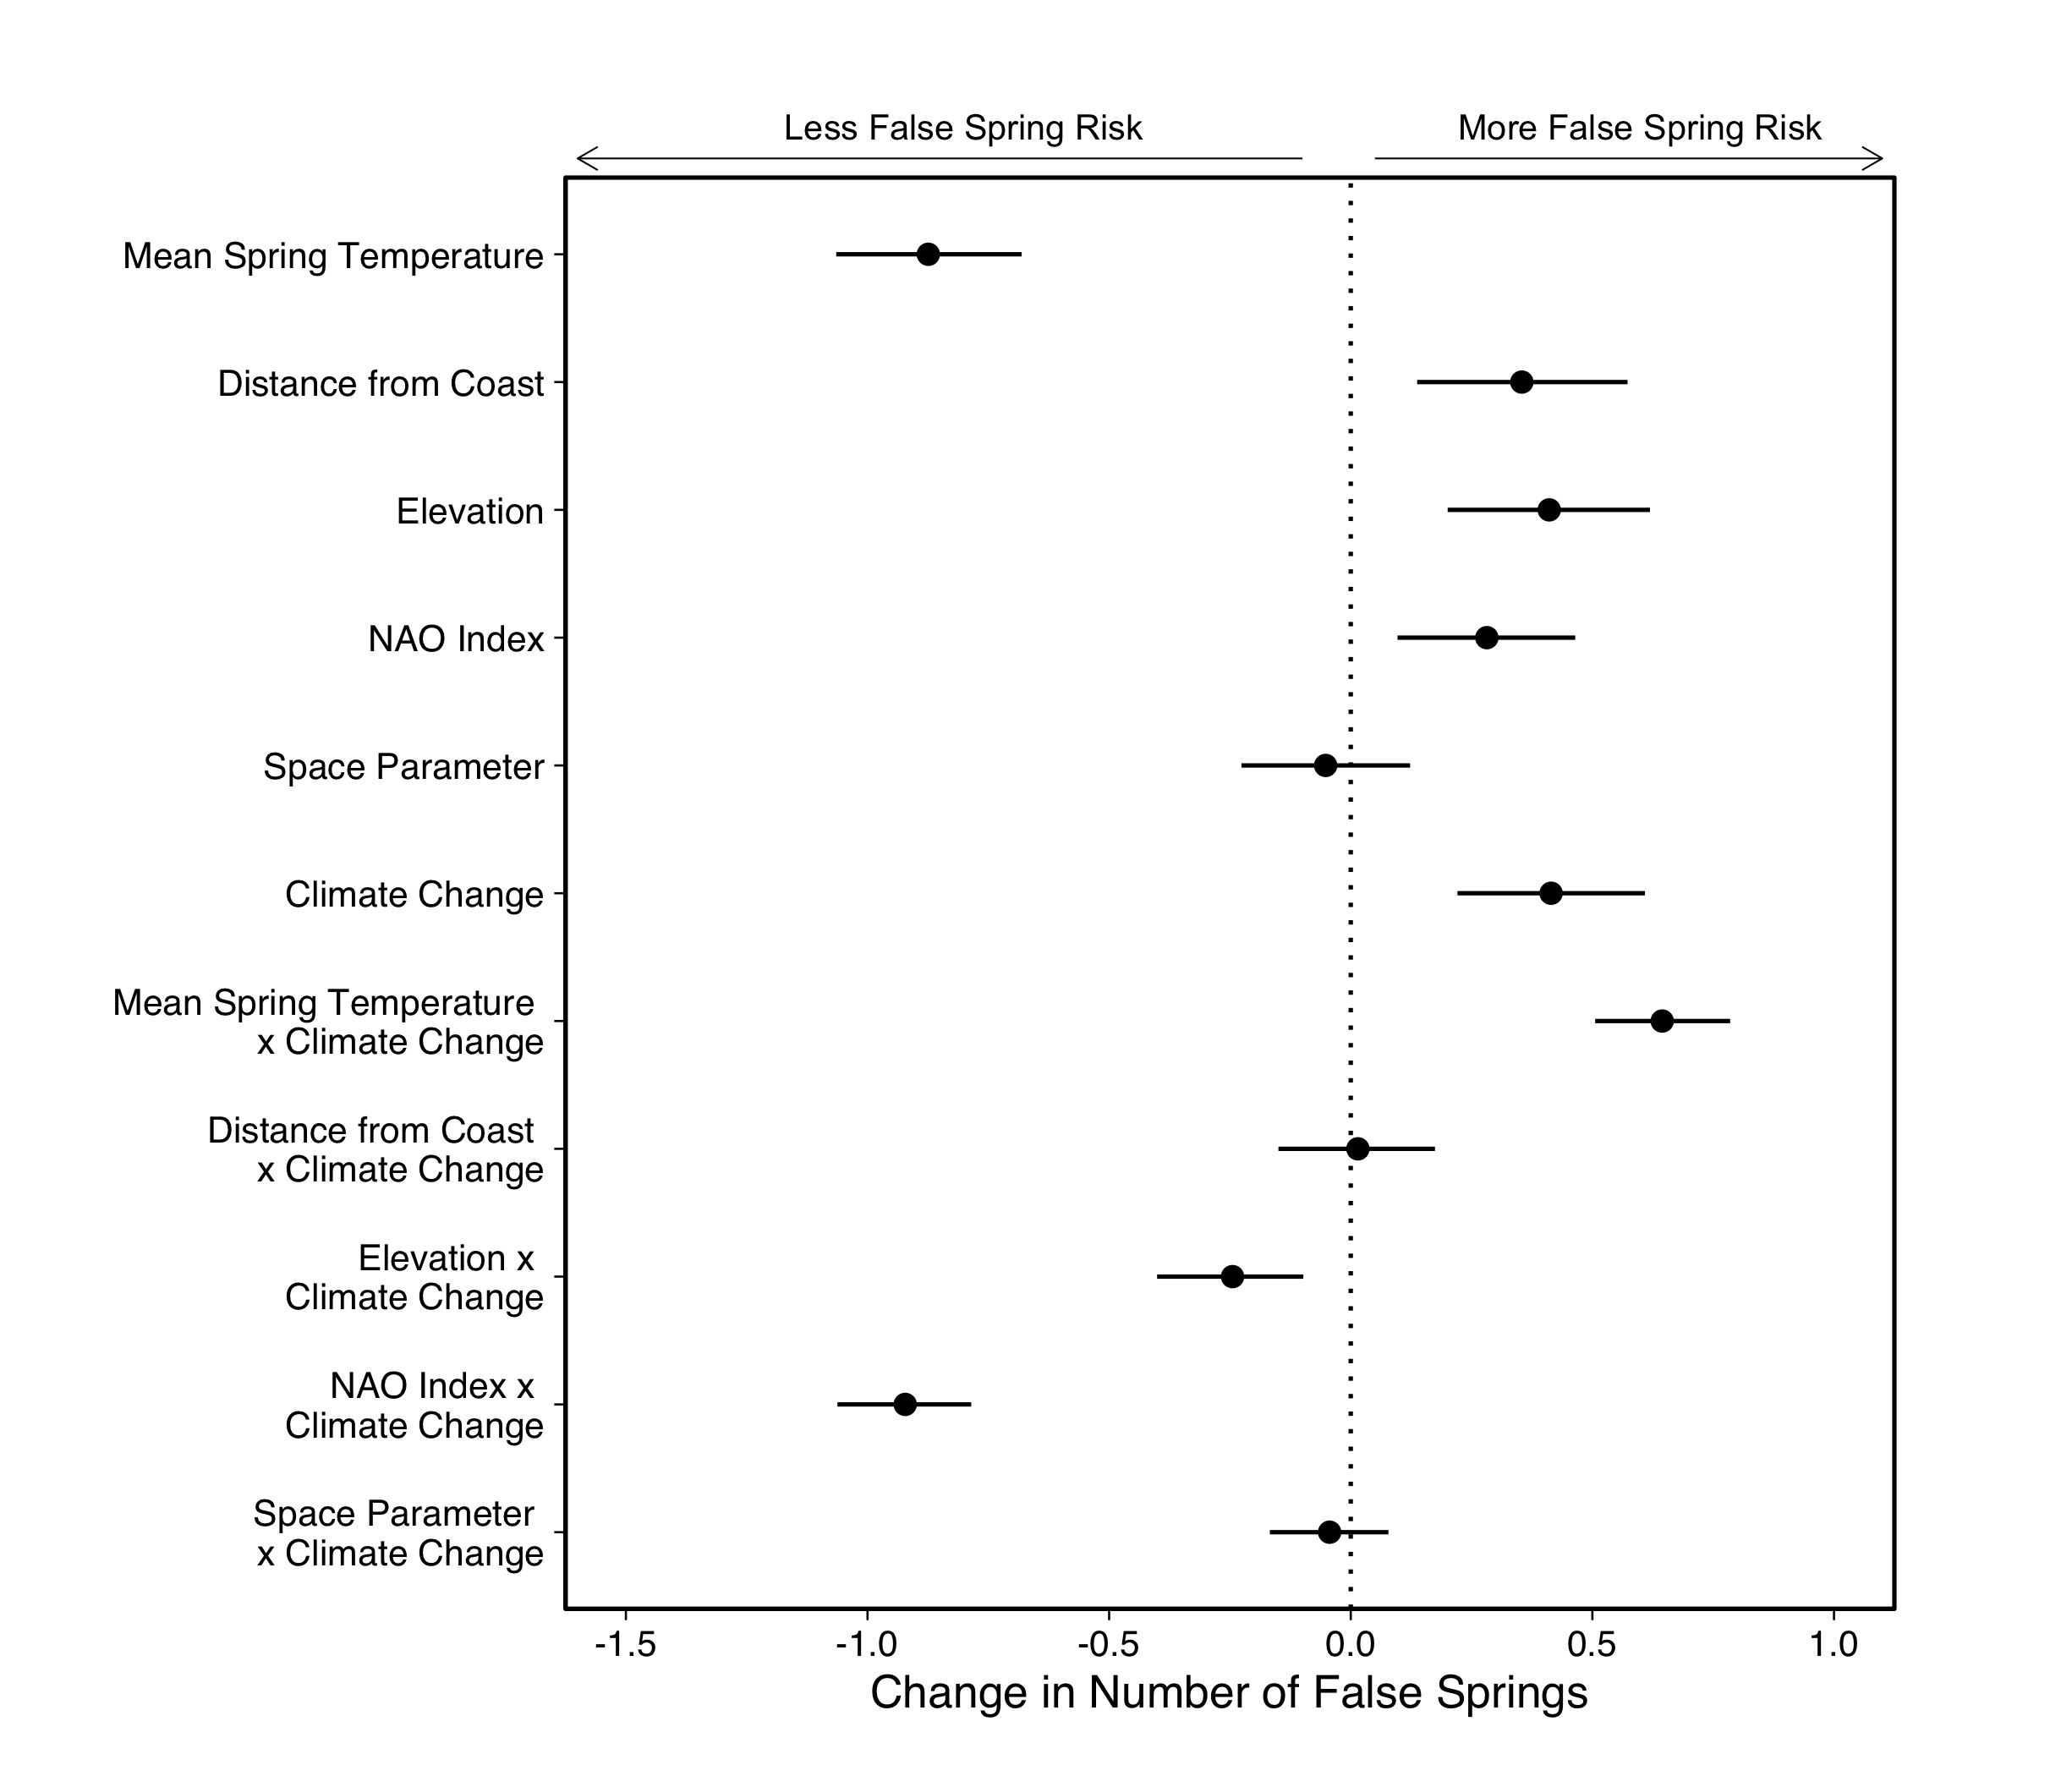
False spring defined as -5ºC

Slide 16
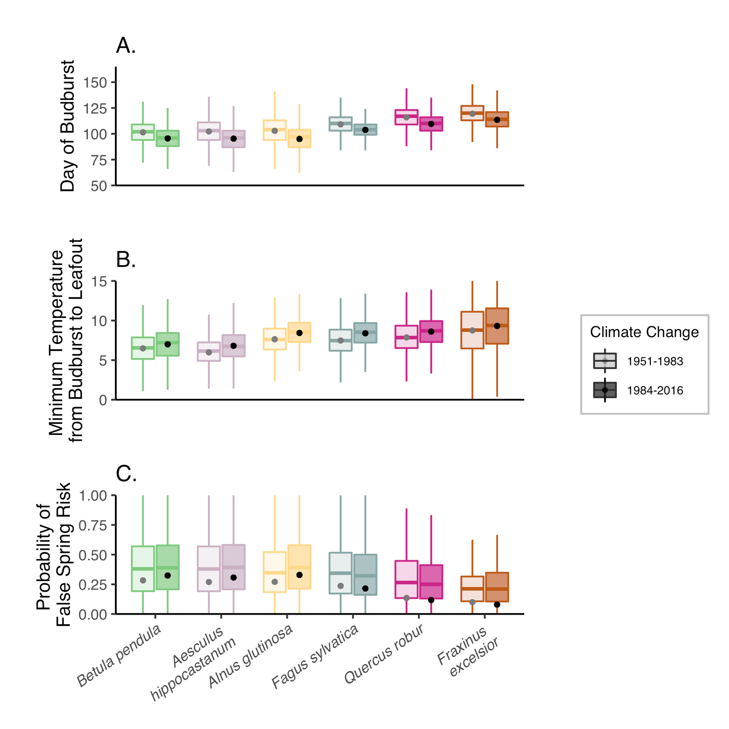

Slide 17
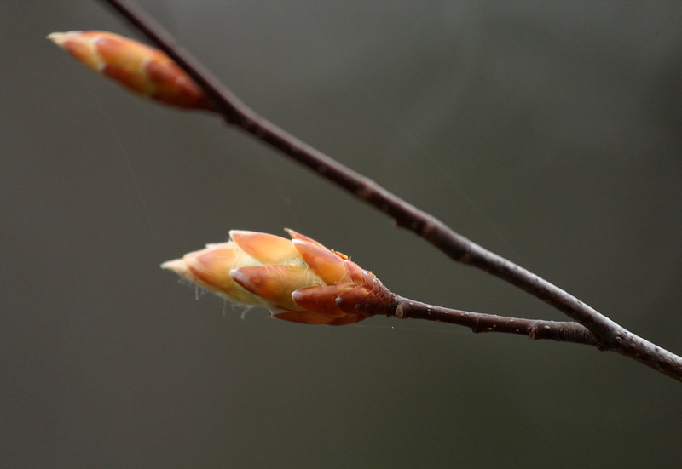
False Springs:
-2.2ºC
BUDBURST
LEAFOUT
DURATION OF VEGETATIVE RISK
Chamberlain et al., 2019
Photos by Suz Mrozak

Slide 18
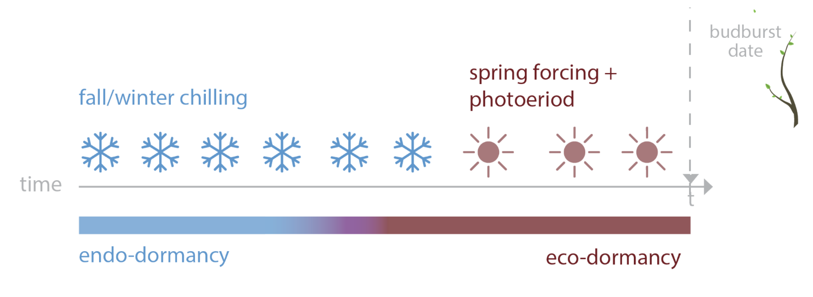

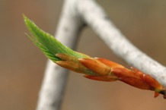
PHENOLOGY USES MULTIPLE CUES
spring warming + daylength
Ettinger et al, in review

Slide 19
Climate change reshapes the drivers of false spring risk in European trees
Cat Chamberlain
Arnold Arboretum – Harvard University

Slide 20
Climate change reshapes the drivers of false spring risk in European trees
Cat Chamberlain
Arnold Arboretum – Harvard University

Slide 21
Climate change reshapes the drivers of false spring risk in European trees
Cat Chamberlain
Arnold Arboretum – Harvard University

